Slide 1
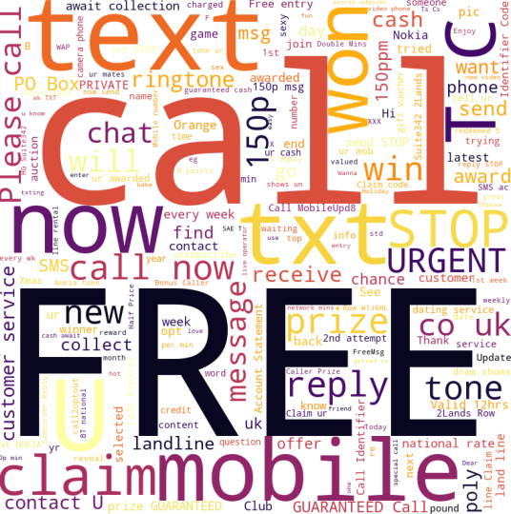
SPAM Classifier
-Algorithm track
Team 21
Nikhil konduru - 015998957
Alekhya Pasupuleti - 016622372
Shravani Naikoti - 016673579

Slide 2

Outline
Problem Statement
Objective
Dataset Overview
Preliminary Analysis
Project Life cycle
Model Summary
Result Comparison
Conclusion

Slide 3

Problem Statement
Due to spammers' rapid development of technology, there is a need for more efficient, generic, and adaptive classifiers. Spam classification using machine learning is an important area of research.

Slide 4

Objective/Proposed solution
Various learning algorithms are investigated and identified to classify spam messages from legitimate text messages in the proposed work.
By providing the data set, we want to train the machine learning algorithm to learn from it and draw conclusions on its own.
Globally, this helps reduce the number of frauds occurring by identifying spam messages.

Slide 5
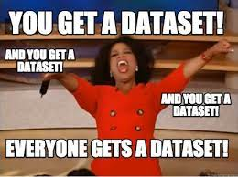
Dataset Overview
Number of Training Samples | Number of Testing Samples | Total
4180 | 1394 | 5574
Dataset : https://archive.ics.uci.edu/ml/datasets/SMS+Spam+Collection

Slide 6
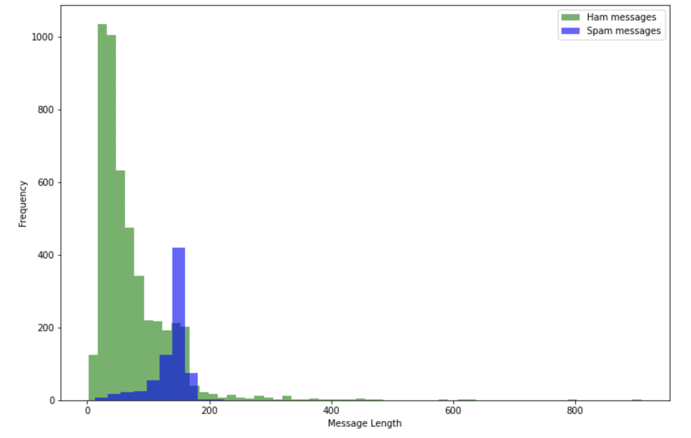
Preliminary Analysis
Feature Engineering was done and length of message was added.
Observation:
We can observe that spam messages are generally longer than ham messages: Bulk of ham has length below 100, for spam it is above 100.

Slide 7
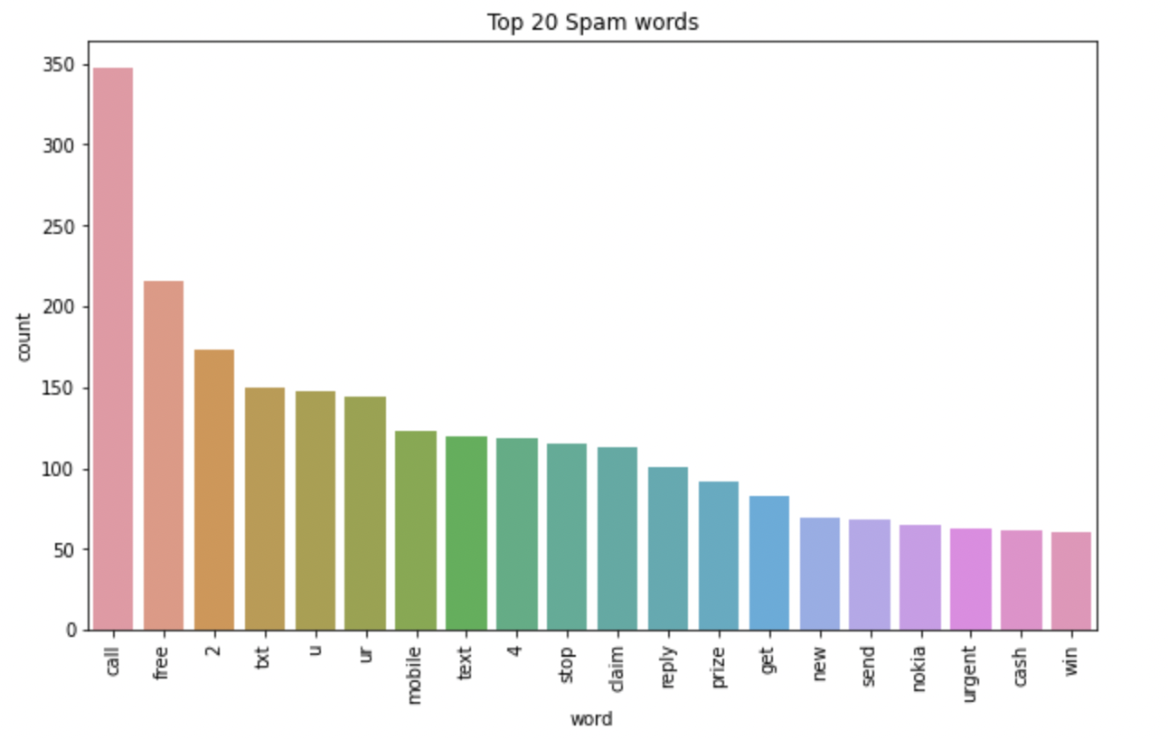
Preliminary Analysis
Most frequent spam word’s counts present in the dataset were plotted.
Observation:
We observe that words like call, free and misspelled words or abbreviations are common in spam messages.

Slide 8
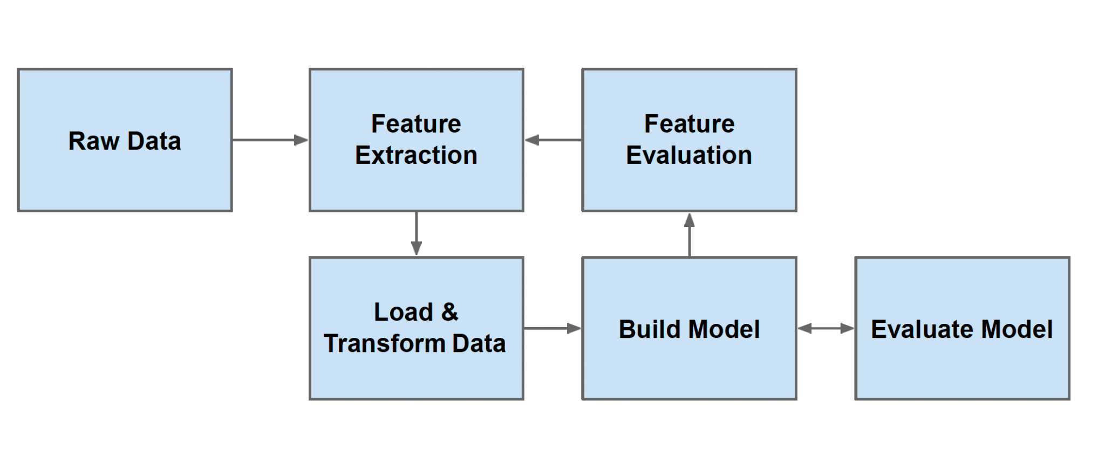
Project Life cycle
Notes:
Generally the life cycle of a machine learning project is as follows.

Slide 9
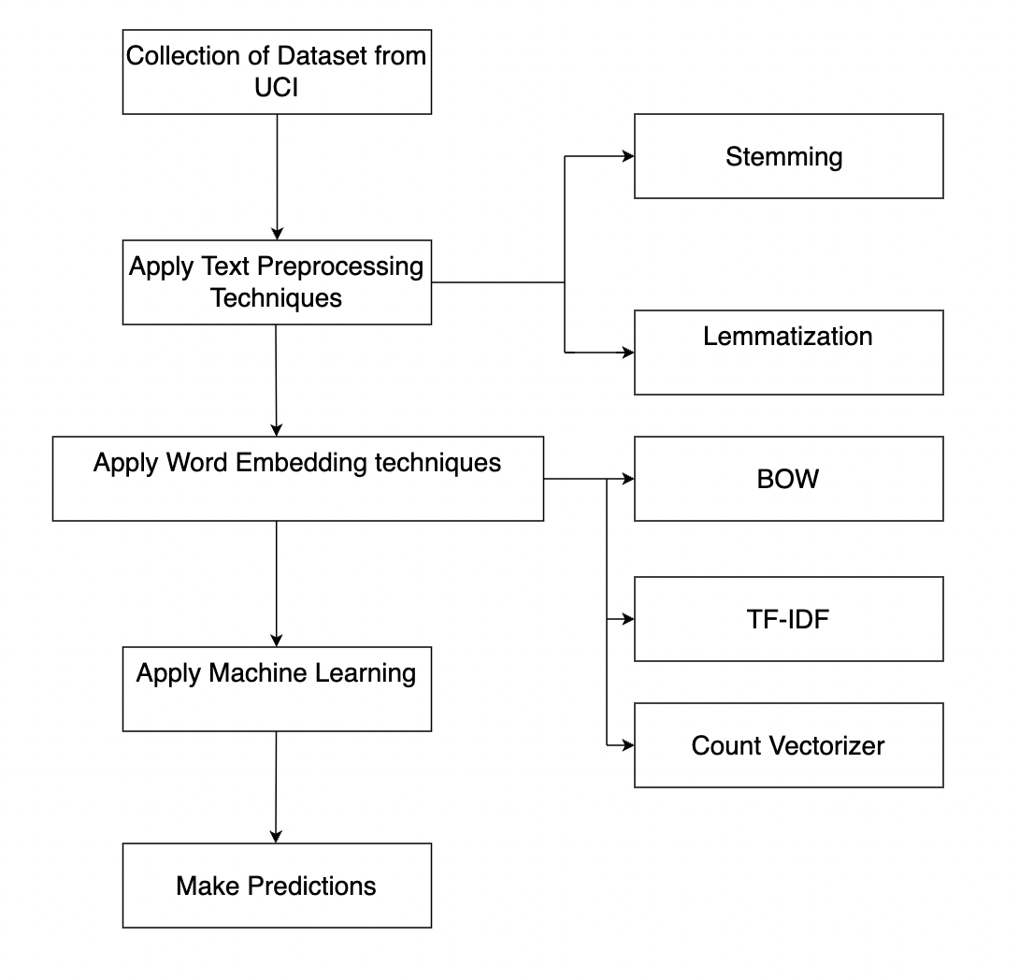
Proposed approach for SMS spam detection

Slide 10
Model Summary
KNN
Naive Bayes
Random Forest
SVC

Slide 11
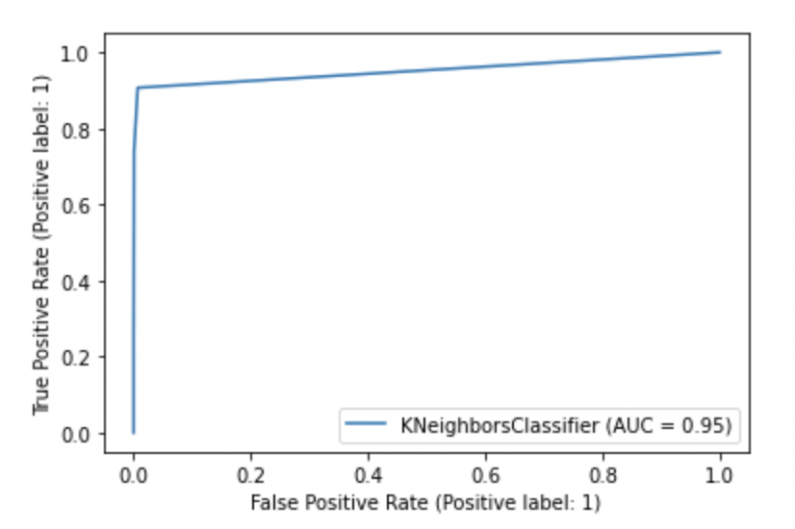
Model Summary Continued….
Accuracy | 0.89
Precision | 1.0
Recall | 0.90
F1-score | 0.94
ROC Score | 0.95
KNN
Notes:
The features of every test data item are compared with the features of every training data item in real time, and then the K nearest training data items are selected, and the most frequent class among them is given to the test data item.

Slide 12
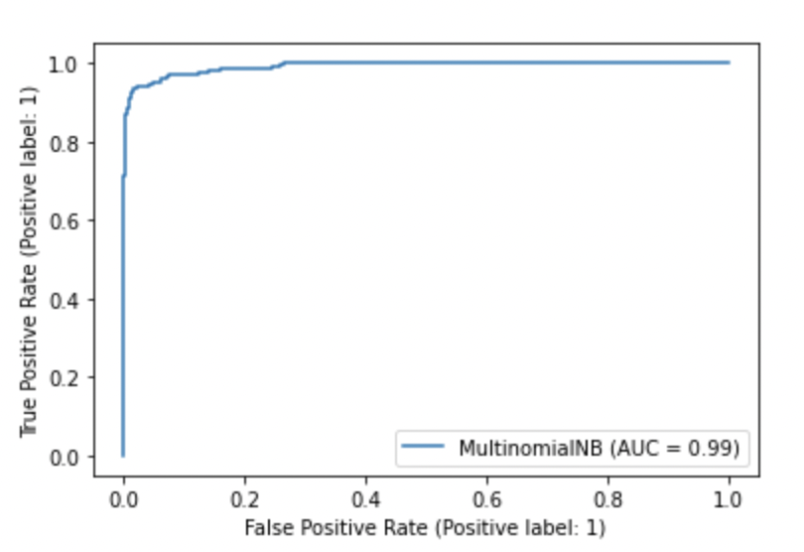
Model Summary Continued….
Multinomial Naive Bayes
Accuracy | 0.96
Precision | 1.0
Recall | 0.96
F1-score | 0.98
ROC Score | 0.99
Notes:
In our case, we have a frequency as a feature. In such a scenario, we use multinomial Naive Bayes. It ignores the non-occurrence of the features. So, if you have frequency 0 then the probability of occurrence of that feature will be 0 hence multinomial naive Bayes ignores that feature.

Slide 13
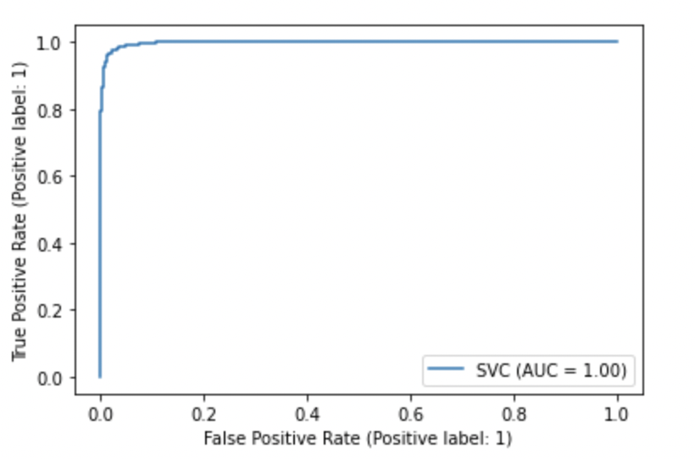
Model Summary Continued….
SVC
Accuracy | 0.97
Precision | 1.0
Recall | 0.97
F1-score | 0.98
ROC Score | 1.0
Notes:
SVM can be used a classifier. As you can see it worked quite well with our dataset.

Slide 14
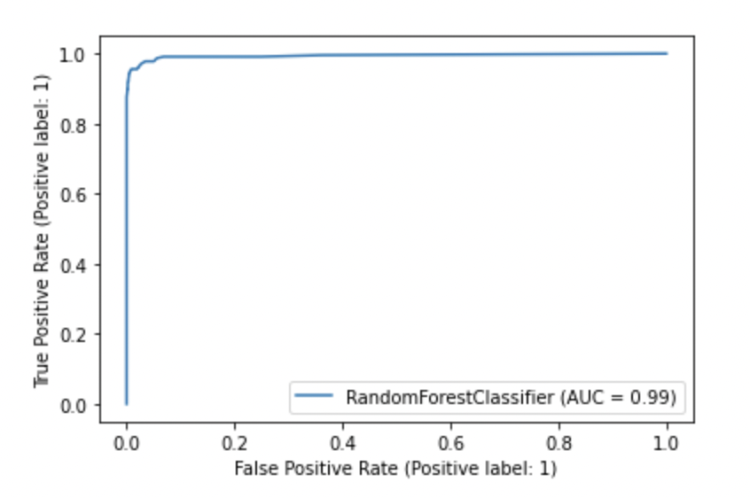
Model Summary Continued….
Random Forest
Accuracy | 0.97
Precision | 1.0
Recall | 0.97
F1-score | 0.99
ROC Score | 0.99
Notes:
RF is basically an ensemble of decision trees which makes it an extremely good classifier.

Slide 15
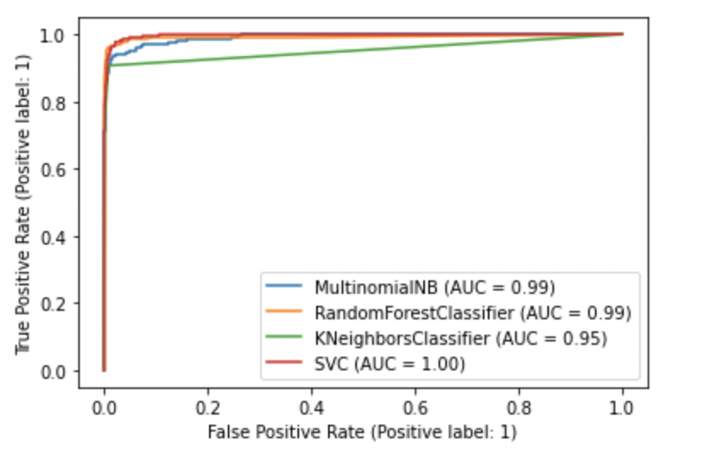
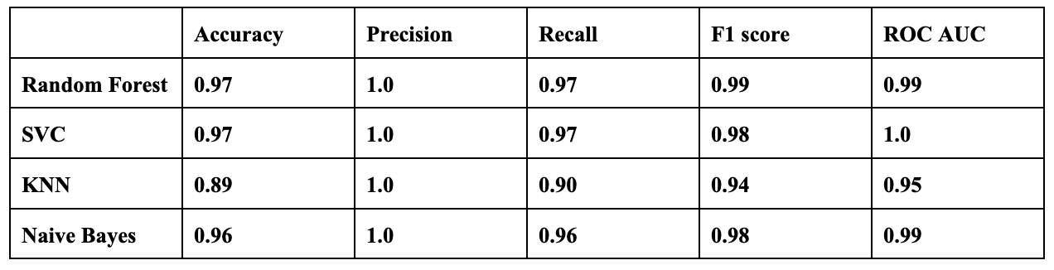
Result Comparison
Notes:
The algorithm analysis is based on factors such as accuracy, precision, recall, f1-score, and ROC. As you can see Random Forest performs exceptionally well on our dataset.

Slide 16
Conclusion
Multinomial Naive Bayes, Random Forest, SVC, and KNN are machine learning classification algorithms that can be used to distinguish between spam and ham messages using the SMS spam collection data set provided.
We used three different word embedding approaches: Bag of Words, Countvectorizer, and TF-IDF.
TF-IDF with Random Forest classification method outperforms other algorithms in the trial in terms of accuracy score. However, because the dataset is unbalanced, judging performance solely on accuracy is insufficient; precision, recall, ROC score, and f1-score of the methods must also be considered.
Following additional testing, the RF algorithm still achieves good precision, f1-score and ROC score.
Notes:
Our approach was simple. First we used stemming and lemmatization. Then since both gave almost similar results, stemming was chosen since it is faster. We have used three different word embedding approaches: Bag of Words, Countvectorizer, and TF-IDF combined with 4 models as discussed.
For each classifier, hyperparameter tuning was done to improve the performance metrics.
TF-IDF with Random Forest classification method outperforms other algorithms in the trial in terms of accuracy score. However, because the dataset is unbalanced, judging performance solely on accuracy is insufficient; precision, recall, ROC score, and f1-score of the methods must also be considered.
Following additional testing, the RF algorithm still achieves good precision, f1-score and ROC score.

Slide 17

Thank you !

